Slide 1
Do Stock Market Liberalizations Cause Investment Booms?
Peter Blair Henry

Slide 2
Introduction
A stock market liberalization is a decision by a country’s government to allow foreigners to purchase shares in that country’s stock market.
Equity price index
Stock market liberalization
Cost of equity
Physical investment

Slide 3
Overview
channels of how stock market liberalization affect aggregate valuation, cost of capital, and investment
Analysis of the correlation of private investment growth and stock market liberalization
Analysis of correlation between the growth rate of private investment and changes in stock market valuation
Alternative explanations for the investment boom

Slide 4
channels of how stock market liberalization affect aggregate valuation, cost of capital, and investment
liberalization =>change cost of capital => fall in cost of equity=>temporary increase in the growth rate of investment
Examine correlation of investment with both liberalization and stock price; if correlation exists, does it give a casual interpretation
Notes:
Endnote 4

Slide 5
Analysis of the correlation of private investment growth and stock market liberalization
Existing evidence on the impact of liberalization on risk sharing,valuation and liquidity
Whether investment is usually high following stock market liberalization
Result: investment booms consistently follow stock market liberalizations

Slide 6
Analysis of correlation between the growth rate of private investment and changes in stock market valuation
Study shows the higher stock returns forecast increased future investments in the U.S.
LDCs – financial repression, government directed credit and the prevalence of informal financial market
Regression of private investment growth on stock returns demonstrate a positive and significant correlation
Notes:
Recent studies say it’s not obvious that the standard investment stock return correlation will hold.

Slide 7
Alternative explanations for the investment boom
Whether omitted variables or reserve causality can explain the investment liberalization correlations?
Omitted variables:
Political decision to liberalize may be endogenous: government has an incentive to liberalize the stock market when there is good news about the future (1.high points in business cycle 2.implementation of other economic reforms 3. positive shocks to aggregate demand and the terms of trade)
Liberalization still has significant effect on the growth rate of private investment

Slide 8
Reserve causality
Time evidence suggests that stock markets are not liberalized in response to investment booms
However,the evidence can’t rule out the possibility that policy makers liberalize in anticipation of future shocks to the marginal product of capital.

Slide 9
Stock Market Liberalization, Stock Prices, and Investment: Theory
Stock price
denote expected aggregate profit per unit of capital
denote the expected present value of aggregate profit per unit of capital
be the autarky domestic real interest rate
be the autarky equity premium
world risk free rate, <
Notes:
Endnote 9: Assuming no bubbles, this is precisely the value of the country’s stock market. We are also making here the simplifying assumption that all profits are paid out as dividends.

Slide 10


be the price of a unit of physical capital
the market for capital is in equilibrium and firms are indifferent to investing

Slide 11

Assume the domestic savings rate is constant, the capital inflow generated by stock market liberalization increases the total stock of loanable funds. This increase could cause the domestic risk-free rate to fall.
be the post-liberalization risk-free rate
It generates an incentive for firms to invest in physical capital

Slide 12
Stock Market Liberalization, Stock Prices, and Investment: Facts
Stock Market Liberalization Dates
Defined as the first month of:
1.liberalization by policy decree
2.establishment of the first country fund
3.an increase in the IMF’s investability index of at least 10 percent

Slide 13
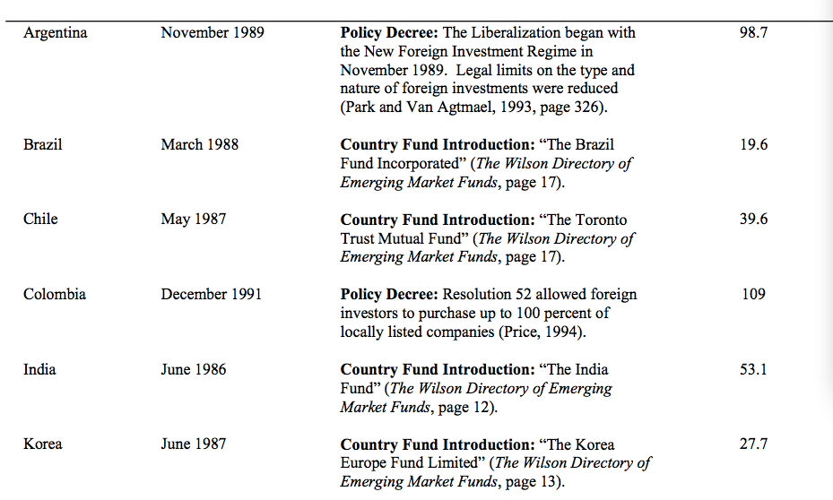
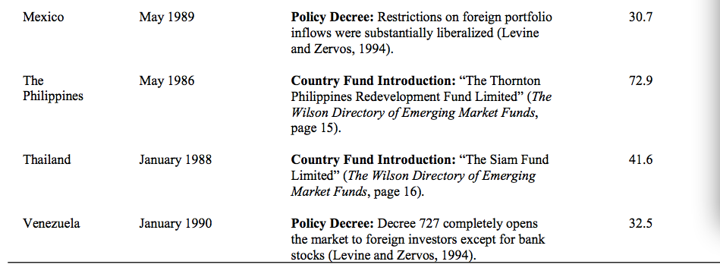

Slide 14

as the real growth rate of private investment in country i in year t
α are country-specific dummies. Year it
are year-specific dummies.
Libi is a variable which takes on the value 1 in the year t that country i liberalizes its stock market;
PostLibji takes on the value 1 in the j year after liberalization

Slide 15
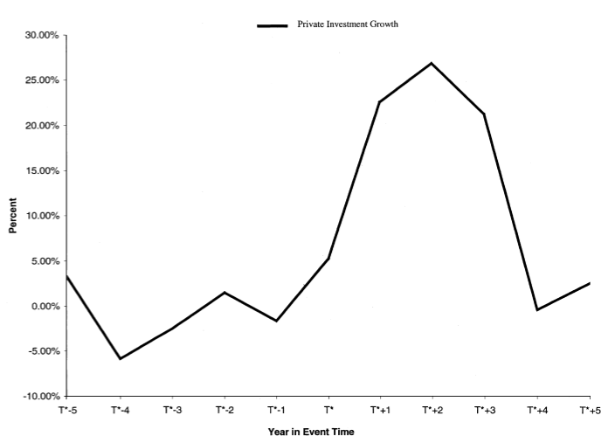

Slide 16
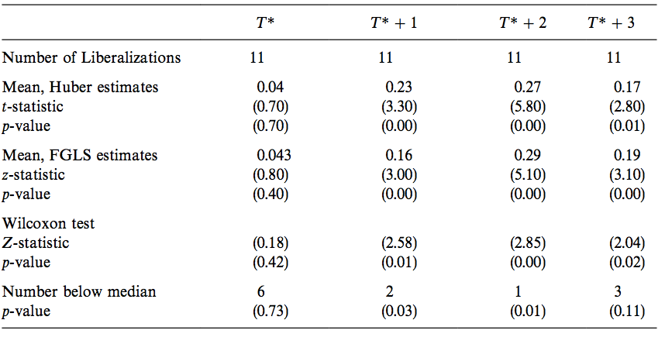

Slide 17
The result of feasible generalized least squares (FGLS), which allows for for groupwise autocorrelation, suggest that autocorrelation is not a major statistical concern
Outlier: Wilcoxon signed rank test and Z-statistics
High growth rate of private investment in each of the three years is a robust empirical regularity not driven by a few countries

Slide 18
Foreign Direct Investment
Increase in private investment does not simply substitute for FDI
Private investment ,the ratio of FDI to private investment increases, and the sum of private investment and FDI all increases
One explanation is stock market liberalization may be positively correlated with other changes that reduce the operating risk of foreign multinationals operating in an LDC.

Slide 19
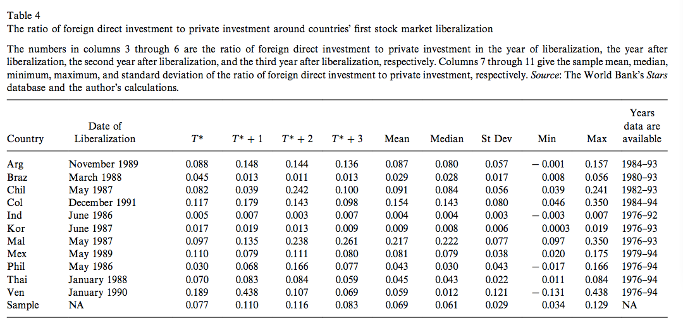

Slide 20


Investment-Stock Return Correlations
Let and denote the real local currency value of private investment and the stock market index in country i in year t
let
Stock returns in year t −1 strongly predict investment in year t while contemporaneous and two-year- lagged returns have little predictive power

Slide 21
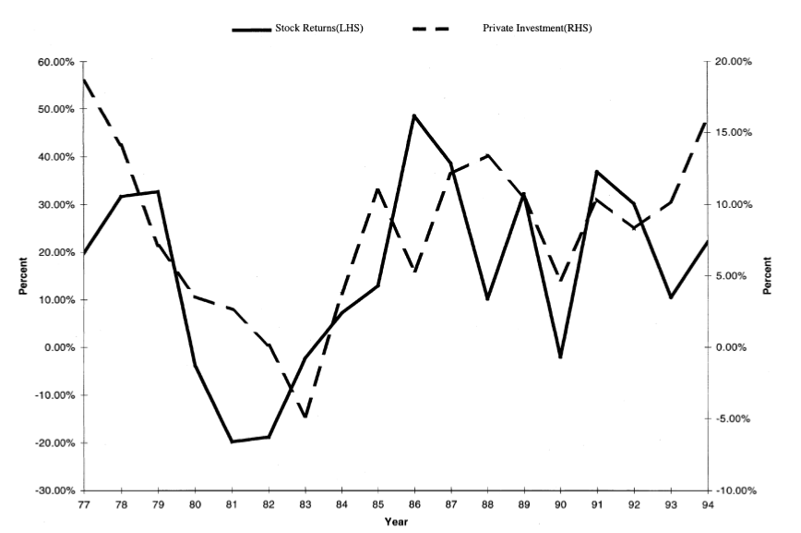

Slide 22
The Correlation of Investment and Liberalization-Specific Valuation Changes
If there is no difference in the responsiveness of private investment to liberalization-specific and generic valuation increases, then we should observe:
The correlation is stronger for liberalization-specific valuation changes than for generic valuation changes
Notes:
β4 , the coefficient on the interactive term, PostLib2*vt−2 , is positive and significant and an F- test reveals that it is statistically larger than the coefficient on vt−2 .

Slide 23
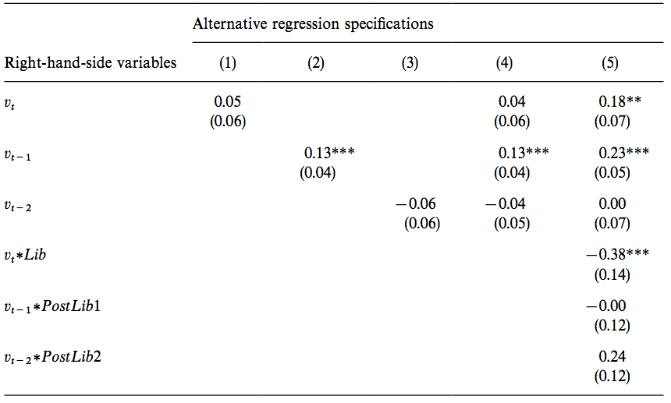

Slide 24

Alternative Explanations for the Investment Boom --Omitted Variables
four economic reform variables : Stabilize, Trade, Privatize, and Exchange
Stronger GDP growth or a positive terms of trade shock could lead to investment boom.
BCYCLE is an abbreviation for the variables which proxy for the world business cycle
Reforms denotes the matrix of reform variables
Fundamentals are two lags of the growth rate of GDP ,terms of trade, debt-to-GDP ratio.

Slide 25
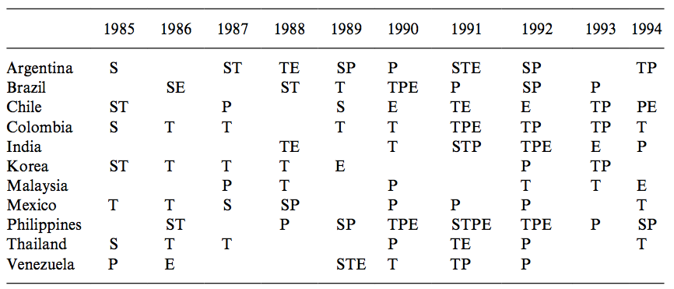

Slide 26
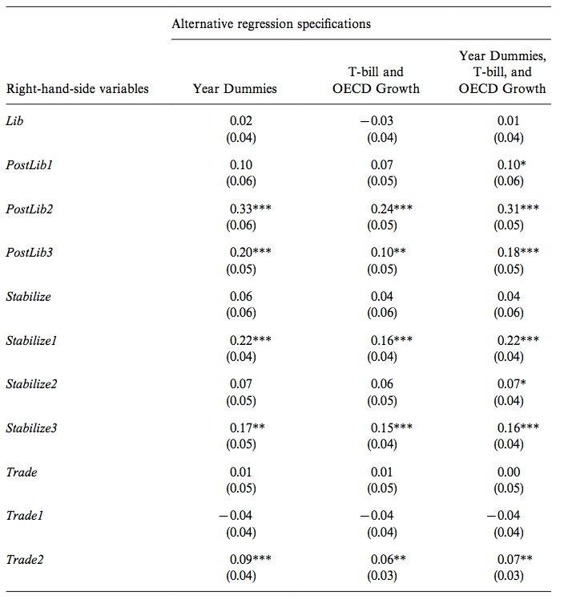

Slide 27
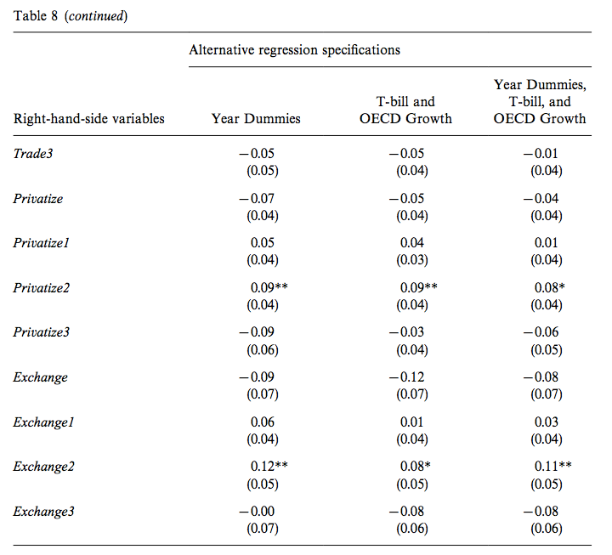

Slide 28
Investment liberalization correlations are robust to a number of potential omitted variables.
However the effect of stock market liberalization on investment is reasonably robust to the omitted variable critique.

Slide 29
Alternative Explanations for the Investment Boom --Reserve Causality
Why the equation may run in the opposite direction?
1. governments might liberalize in response to abnormally high investment demand in previous years
2. an exogenous fall in the world cost of capital relative to the local cost could cause governments to open the domestic stock market to foreigners
3. policymakers might liberalize in anticipation of positive future shocks to the marginal productivity of capital

Slide 31
Conclusion
We can‘t necessarily conclude that stock market liberalization cause investment booms since exogenous falls in the world cost cost of capital and expected shocks to the future marginal productivity of domestic capital could cause both the investment booms and the liberalization.
This paper proved that stock market liberalizations will cause a temporary increase in growth rate of investment which cannot be explained away by world business cycle effects, contemporaneous economic reforms, or domestic aggregate demand conditions, suggests that capital account liberalization may matter for investment after all.

Slide 32
Thank you
present by Yinan Xu

